Slide 1
Lecture 14

Slide 2
Public-Key Cryptography

Slide 3
Conventional cryptography
traditional private/secret/single-key cryptography uses one key
shared by both sender and receiver
if this key is disclosed communications are compromised
also is symmetric, parties are equal
hence does not protect sender from receiver forging a message & claiming it’s sent by sender
Pros and Cons

Slide 4
Public-Key Cryptography
In public-key schemes, each person has two keys
Public key: Known to everybody
Private key: Only known by that person
Keys come in pairs: every public key corresponds to one private key
Uses number theory
Examples: Modular arithmetic, factoring, discrete logarithm problem, Elliptic logs over Elliptic Curves
Contrast with symmetric-key cryptography (uses XORs and bit-shifts)
Messages are numbers
Contrast with symmetric-key cryptography (messages are bit strings)

Slide 5
Public-key Cryptography
Benefit: No longer need to assume that Alice and Bob already share a secret
Benefit:
Drawback:
Drawback: Much slower than symmetric-key cryptography
Number theory calculations are much slower than XORs and bit-shifts

Slide 6
Public-key cryptography
public-key/two-key/asymmetric cryptography involves the use of two keys:
a public-key, which may be known by anybody, and can be used to encrypt messages, and verify signatures
a private-key, known only to the recipient, used to decrypt messages, and sign (create) signatures
is asymmetric because
Not the same key
those who encrypt messages or verify signatures cannot decrypt messages or create signatures

Slide 7



Public-Key Encryption
Everybody can encrypt with the public key
Only the recipient can decrypt with the private key

Slide 8
Public-Key Encryption: Definition
Three parts:
KeyGen() → PK, SK: Generate a public/private keypair, where PK is the public key, and SK is the private (secret) key
Enc(PK, M) → C: Encrypt a plaintext M using public key PK to produce ciphertext C
Dec(SK, C) → M: Decrypt a ciphertext C using secret key SK
Properties
Correctness: Decrypting a ciphertext should result in the message that was originally encrypted
Dec(SK, Enc(PK, M)) = M for all PK, SK ← KeyGen() and M
Efficiency: Encryption/decryption should be fast
Security: 1. Alice (the challenger) just gives Eve (the adversary) the public key, and Eve doesn’t request encryptions. Eve cannot guess out anything; 2. computationally infeasible to recover M with PK and ciphertext

Slide 9
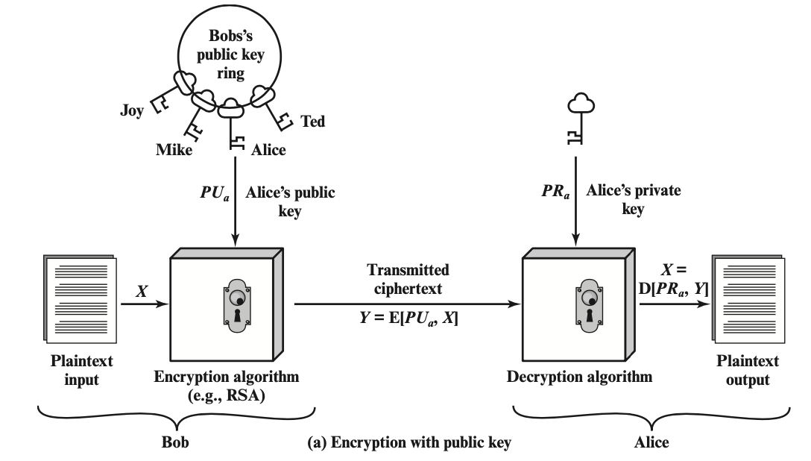
Public-Key Cryptography - Encryption

Slide 10
Encryption steps
step1: generate a pair of keys
step2: keep the private key / secret key (SK) and distribute the public key (PK) – place PK in a public register or other accessible file
step3: Bob encrypts the message with Alice’s PK
step4: upon receiving the ciphertext (CT), Alice decrypt CT with SK

Slide 11
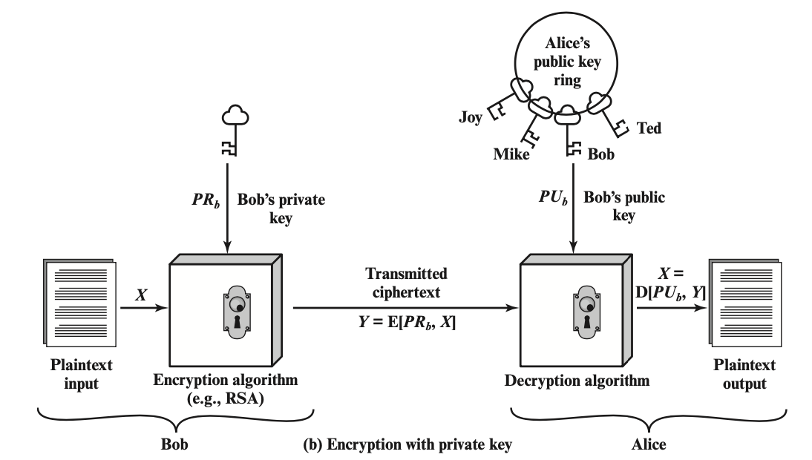
Public-Key Cryptography - Signature

Slide 12
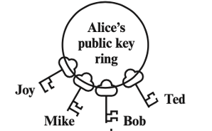

Review
Public Key
Encryption
Private Key
Signature

Slide 13
Why Public-key cryptography?
developed to address two key issues:
key distribution – how to have secure communications in general without having to trust a KDC with your key
digital signatures – how to verify a message comes intact from the claimed sender
public invention due to Whitfield Diffie & Martin Hellman at Stanford Uni in 1976
https://news.stanford.edu/press-releases/2016/03/01/pr-turing-hellman-diffie-030116/

Slide 14
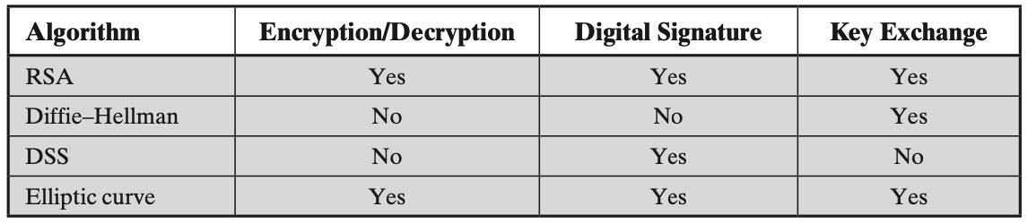
Public-Key application
can classify uses into 3 categories:
encryption/decryption (provide secrecy)
digital signatures (provide authentication)
key exchange (of session keys)
some algorithms are suitable for all uses; others are specific to one
Either of the two related keys can be used for encryption, with the other used for decryption

Slide 15
Security of Public Key Schemes
like private key schemes brute force exhaustive search attack is always theoretically possible
but keys used are too large (>512bits)
security relies on a large enough difference in difficulty between easy (en/decrypt) and hard (cryptanalyze) problems
more generally the hard problem is known, it’s just made too hard to do in practice
requires the use of very large numbers
hence is slow compared to private/symmetric key schemes

Slide 16
Mid-term Exam
March 8, 2023 from 9:00 am – 9:50 am
In class
Close book, no cheat

